Slide 1
AdoptEase
Making Pet Adoption & Care Easy and Loving
SURAJ PRAJAPATI (2102900100153 / CSE / C)

Slide 2
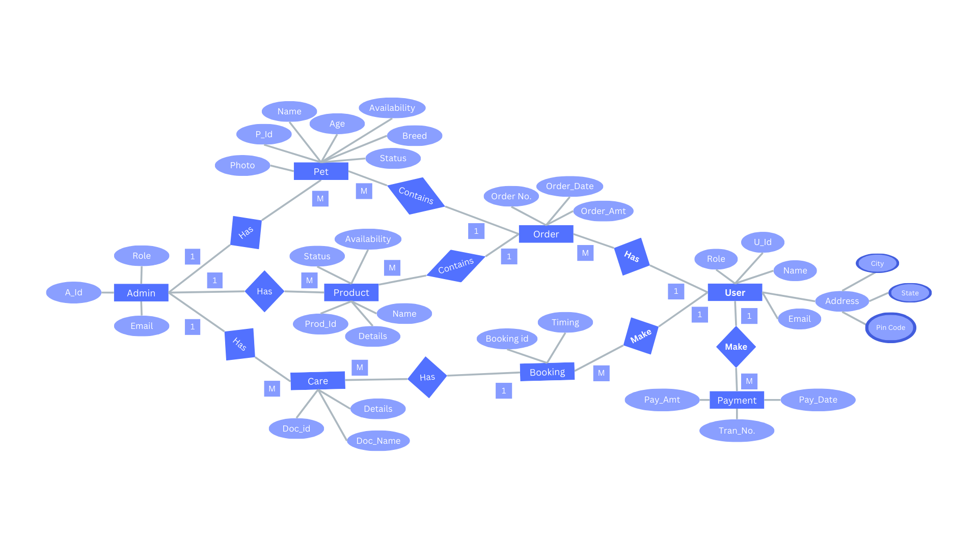
Entity Relation Diagram

Slide 3
Thank You👍

